Slide 1

Project Non-GMO
Mike McCormick
Neil Carrico
James Scott
Bridger Lewis

Slide 2

Background
What are GMOs?
Confusing or inaccurate labeling
Only private organizations verify Non-GMO products

Slide 3
Non GMO Project
Non profit organization
Tests and verifies Non-GMO products
Database of over 26,000 items

Slide 4
Our Vision
Provide Non-GMO verified status
Market to the average consumer
Keep the app quick and clean
Minimalistic UI
Search competing prices
Enjoyable shopping experience

Slide 5





Android
IOS

Slide 6
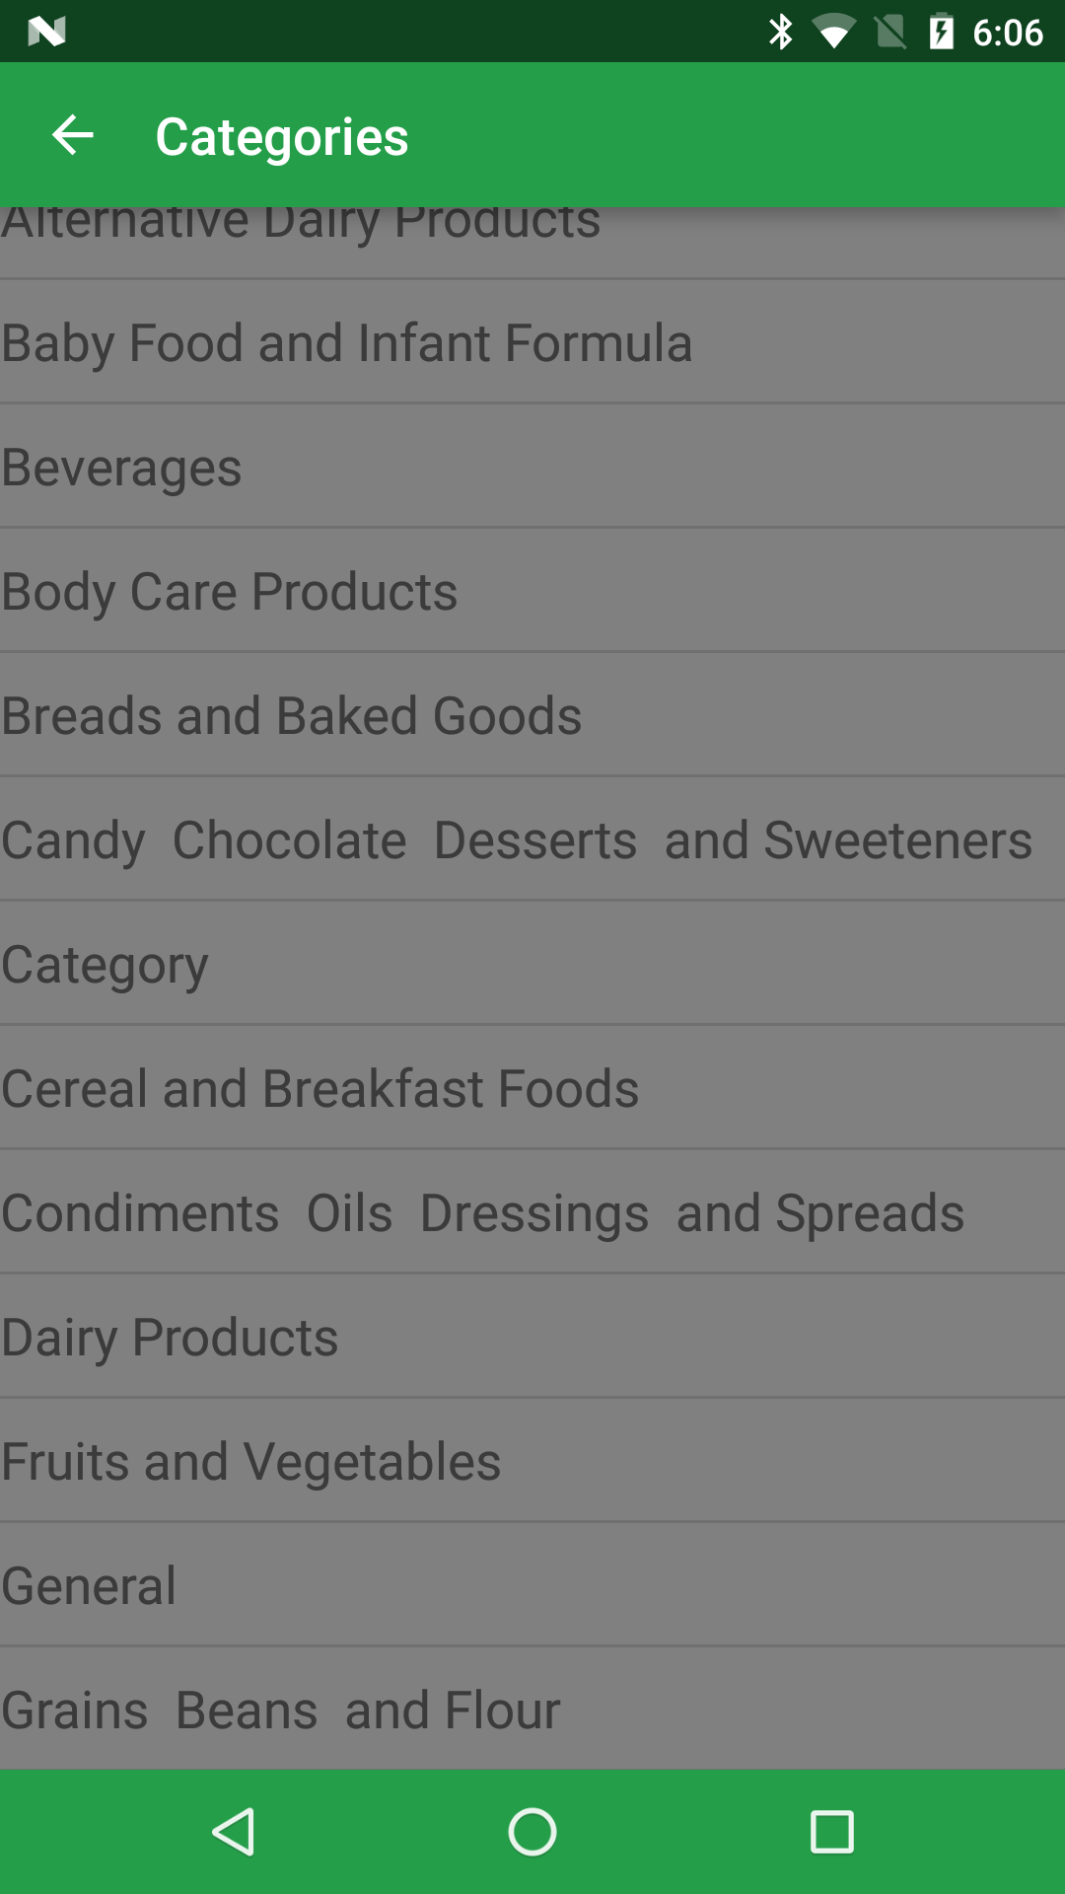
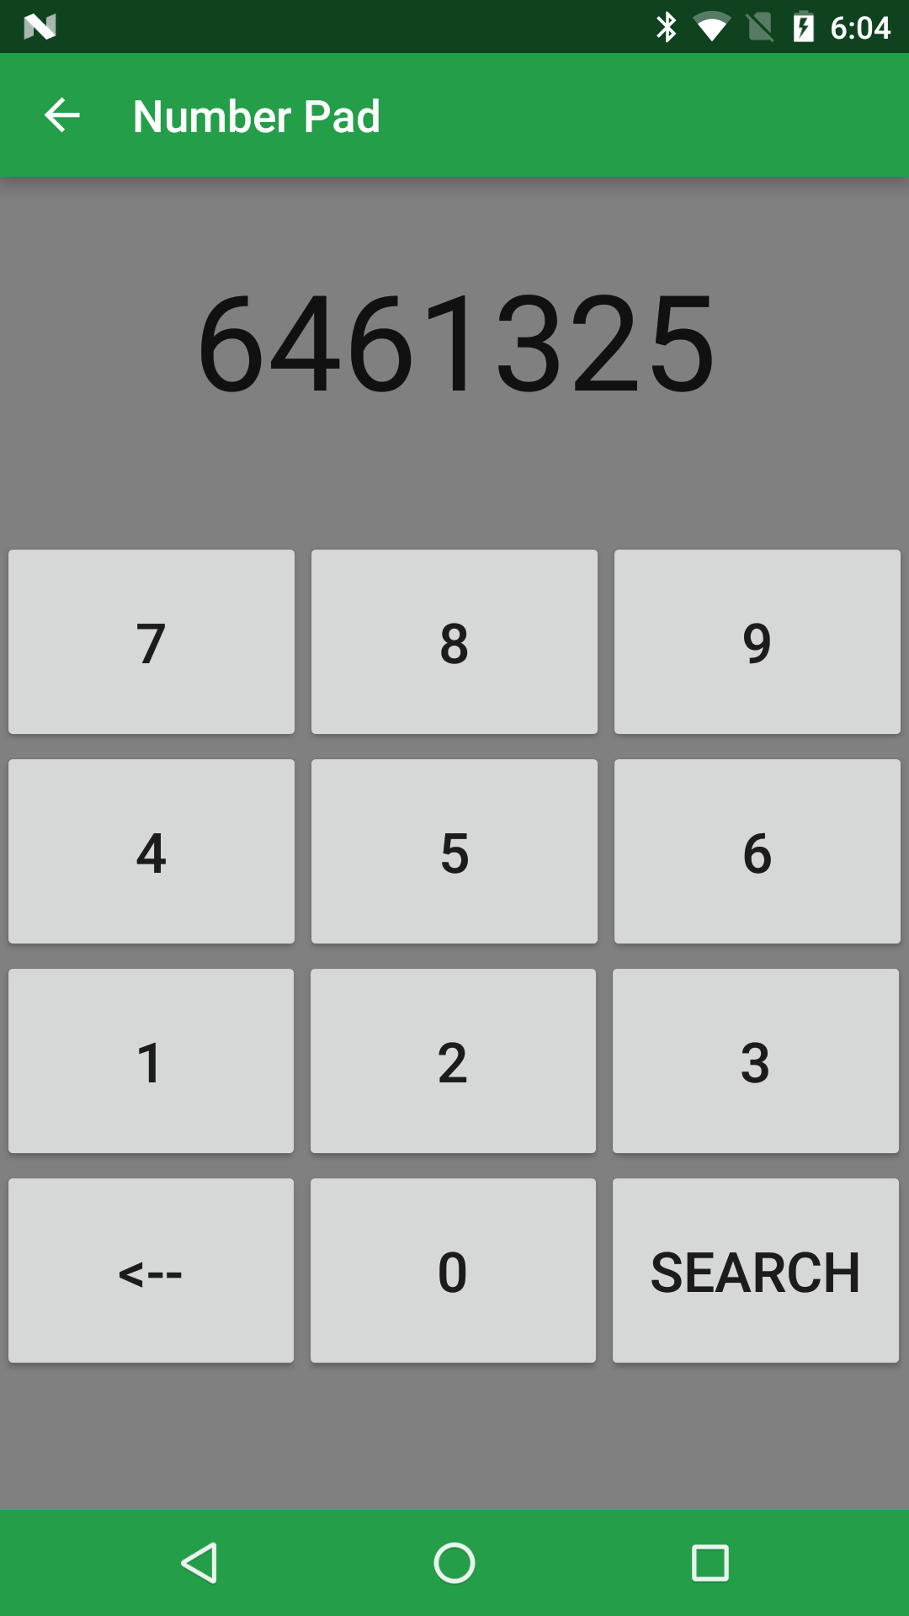


Categories
Manual Input
Scan
Google Vision API
Database
Non-GMO
GMO
Notes:
Why we chose Android. Why we chose SQlite and Vision API

Slide 7
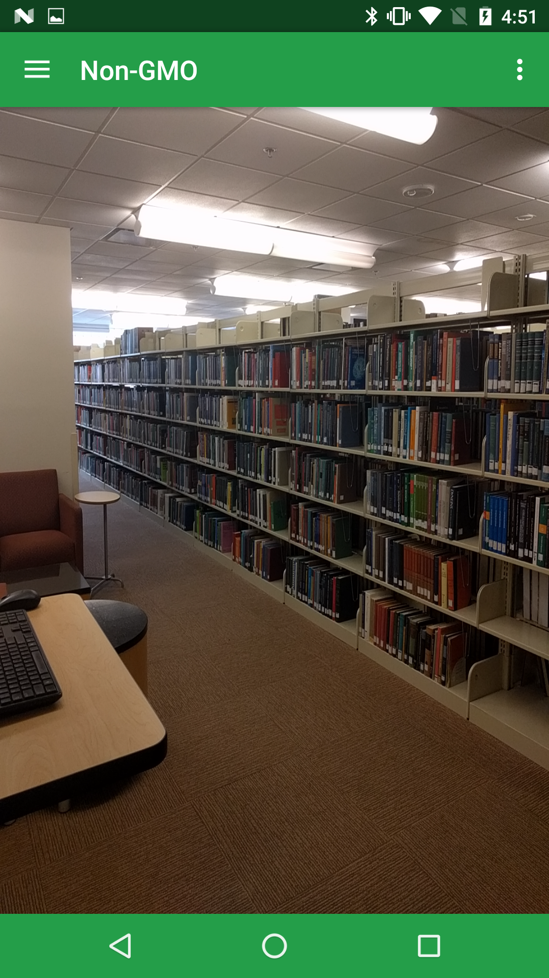
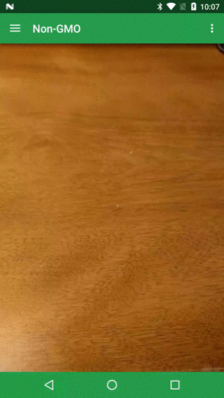

Slide 8
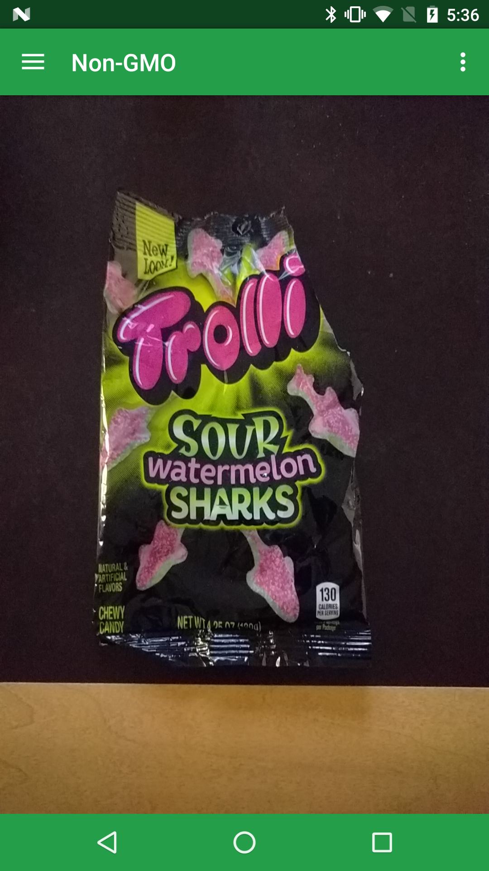
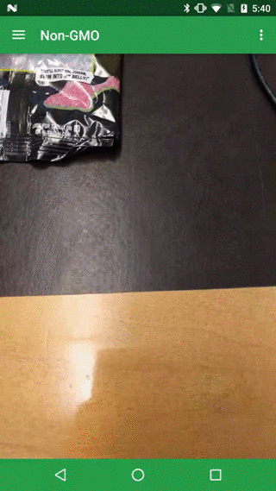
Notes:
You can even see on the M&M package that this product has been partially produced with genetic engineering.

Slide 9
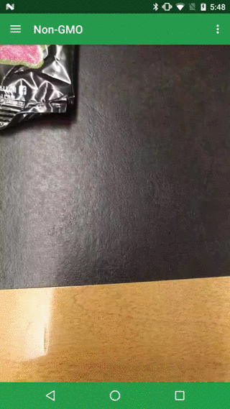
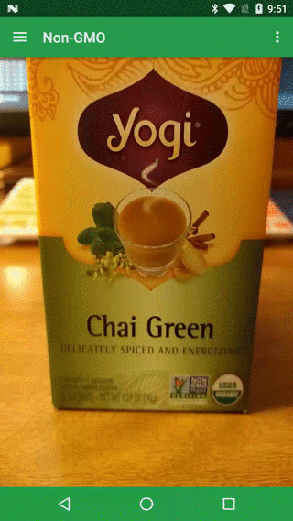

Slide 10
What we learned
Implementing and working with a database in Android
Implementing camera functions with Google Vision API
Working with other groups can be challenging

Slide 11
Future goals of our app
Improve the User Interface
More in depth price comparison
Expand to IOS
Include knowledge of:
Organic
Ingredients
Allergens/Intolerances
Diet restrictions

Slide 12
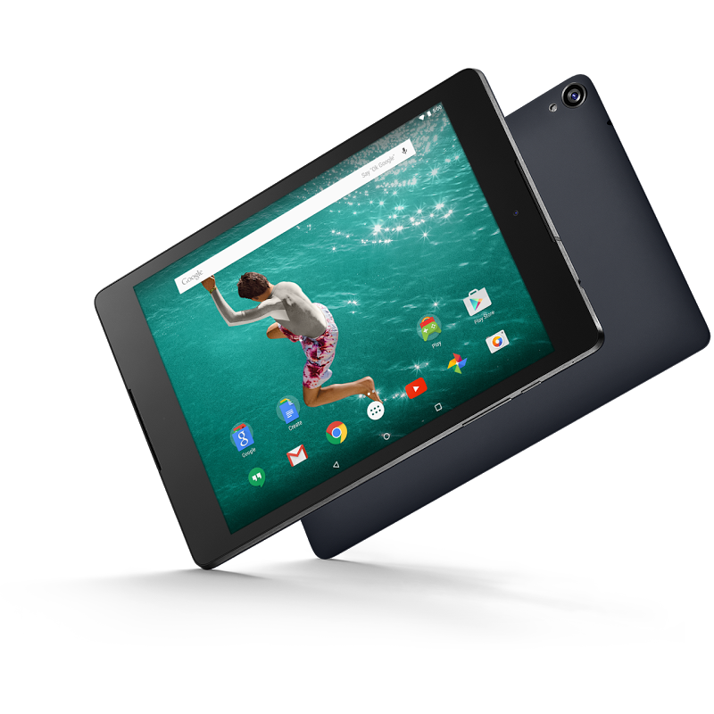
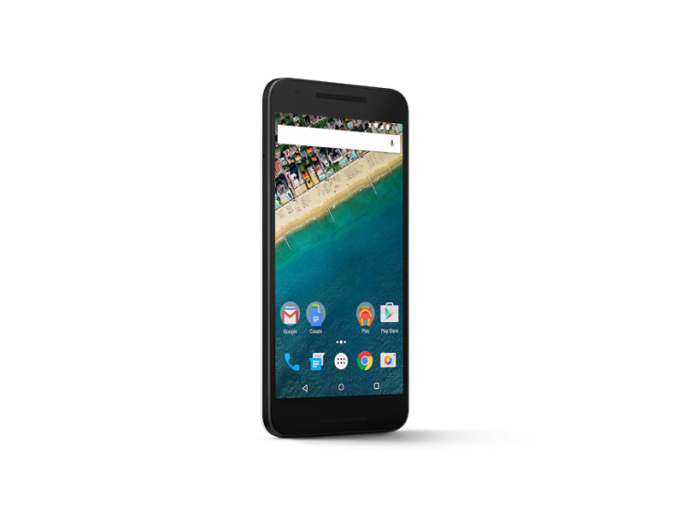

Project Non-GMO
Coming Soon

Slide 13
Thank You
Questions?

